Slide 1

UWA BUSINESS
SCHOOL
B U S I N E S S A N A L Y T I C S
I N D U S T R Y0 P R J E C T
THE UNIVERSITY 0F
WESTERN
› AUSTRALIA

Slide 2

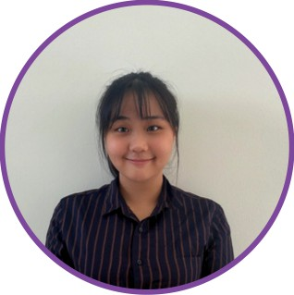
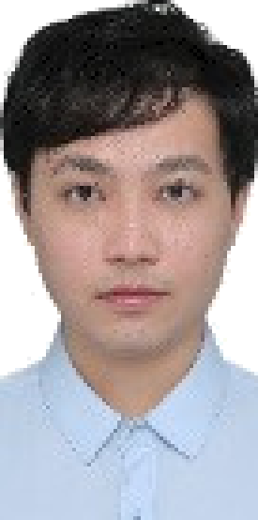
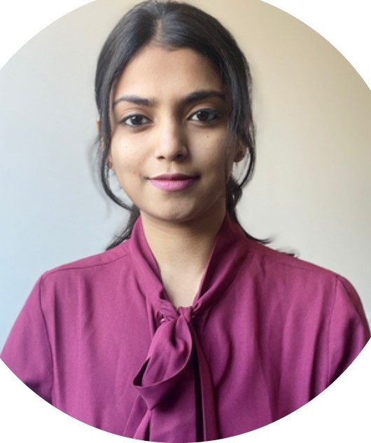




MEET OUR TEAM
CLARICE YEOH
Project Manager
DEREK HE
Assistant Manager
ANUSHA GIRISH
Data Specialist
JINGYU CHEN
Data Analyst
ANTARIKSH WALIA
Technical Specialist
MUIZ GANGANI
Data Specialist

Slide 3














Quantitative investment management company trading in global and financial markets.

Slide 4




PROJECT DESCRIPTION
Utilizing Thrive's systematic approach for analyzing ASX listed ETF themes
O^{r}+ª’ ⁹
Employing Thrive's advanced algorithms in trading technology to make the most of identified patterns.
Analysing market doto to identify non-random patterns and behaviours driving price momentum.
Maximising investor value by understanding and leveraging consistent market effects, focusing on ASX listed ETFs.

Slide 5
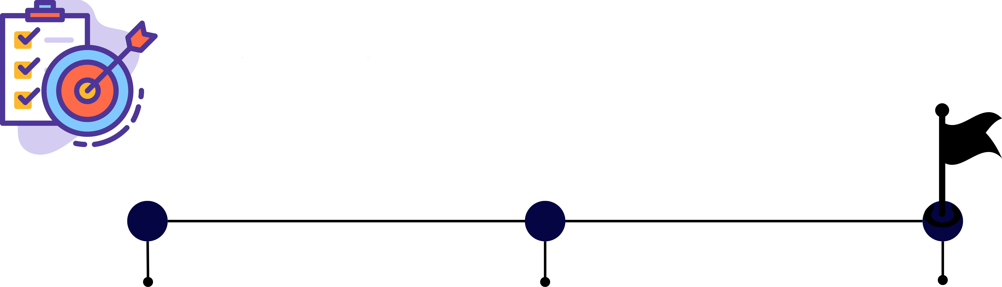
Project Milestone
Phose J: Doto Collection
Phose 2:
Anolysis
Phose 3: Results
Collect data via ASX starting
from 2017—2023
Use the collected indicators (eg.FUM, Transacted Volume) to analyze the ETFs.
Use the top 1 ETFs from each theme to identify the optimal portfolio with the expected return

Slide 6
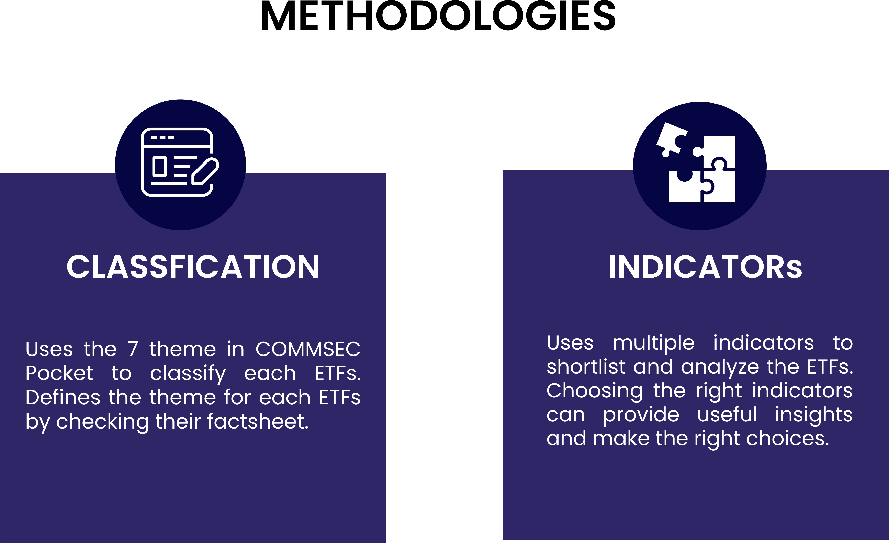

Slide 7














CLASSIFICATIONS
Aussie Top 200
Aussie Dividend
Emerging Market
Track top 200 of the biggest companies in ASX,
including blue chips
Consist of around 30 companies known for paying above average dividends
Consist of diversified accesss to 800+ companies in the world's fast growing economies
Global 100
Health Wise
Tech Sovy
Sustainable Leaders
Exposure to 100+ global blue chips companies
Exposure to 100+ companies with | Exposure to around 100 biggest tech | Exposure to 200+ companies that
medical innovation | innovators and non financial | values sustainable outcomes and
 | companies on NASDAQ | support ESG initiatives

Slide 8
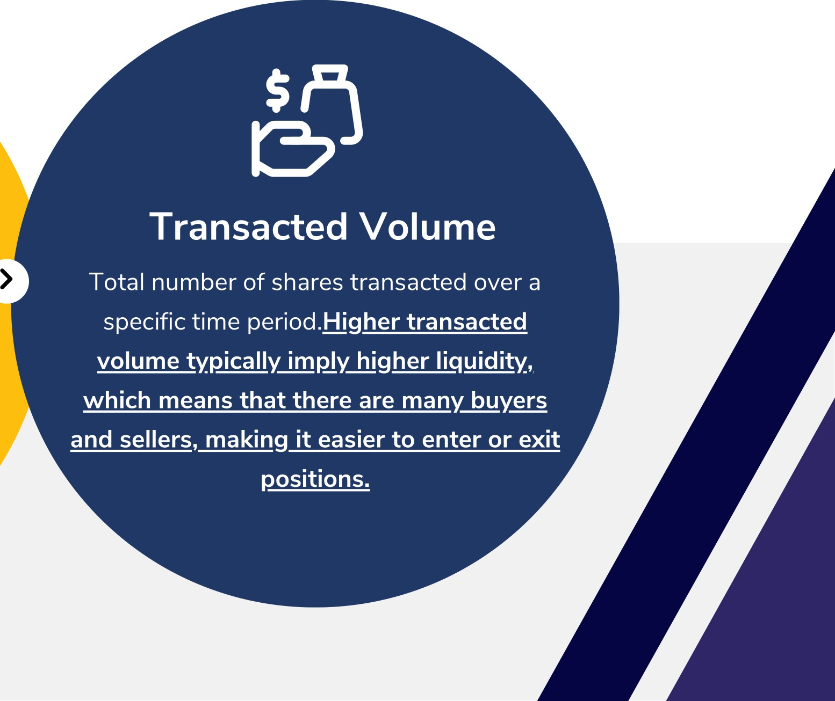




Indicotors
”
Total market value of the assets managed by a financial institution.
Firm with larger FUN have more
diversified portfolios, potentially
reducing risk for investors.

Slide 9








Further Shorlist the ETFs based on tracking index
Let's look into ETFs in Global 100:
Remove IVV from the Top 5 list under
Global JOO
Does not align with our theme of Global 100
Index is mainly made up of large, established US companies
In comparison:
S&P Global 100 Index and MSCI World ex- Australia Index are exposed to mony of the world's largest companies listed in major developed countries
IOO
S&P GLOBAL 100 INDEX
VGS
MSCI World ex-Australia
Index

Slide 10
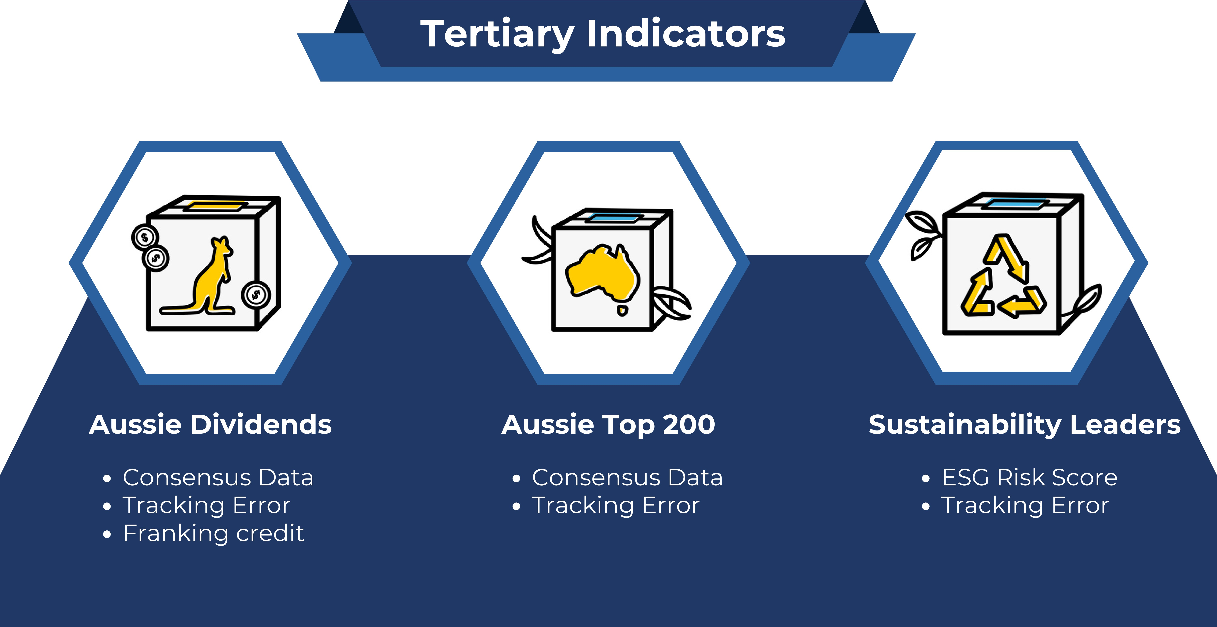

Slide 11
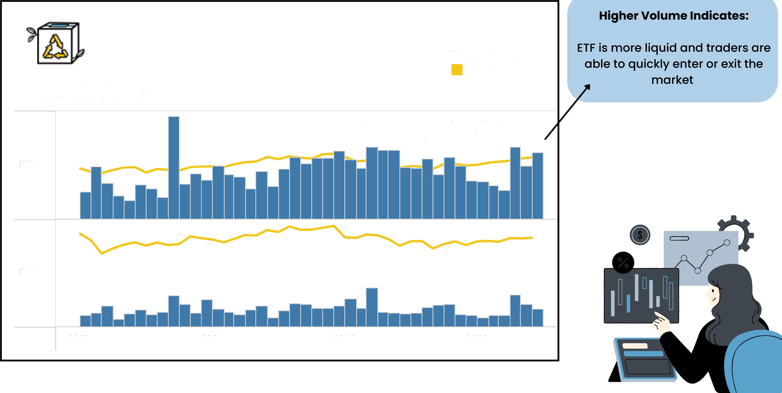
Visuolisotions
SUSTAINABLEEADERS
Measure Names
Avg. Closing Price Avg. Volume
Price and Volume
Lower Price with Higher
Volume
ETHI
FAIR
2020
Z021
2022
Z0Z3

Slide 12



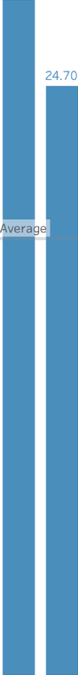








Why sh•auId we look ot ESG risk score
F . HI
Z9.40
Average ESG Risk Score: 18.62
Avg. ESG Risk Score:
16.46
ESG risk score can help investors identify and mitigate potential risks related to gnvironmental,
¿ocial, and governance factors, which might not be captured by traditional financial analysis.
Companies with lower ESG risk score can potentially outperform their peers in the long
run as they might be better managed and more forward-thinking.
17.20 17.10
16.70
1530
14.90
13.50
13. 1D
1Z60
9.60

Slide 13

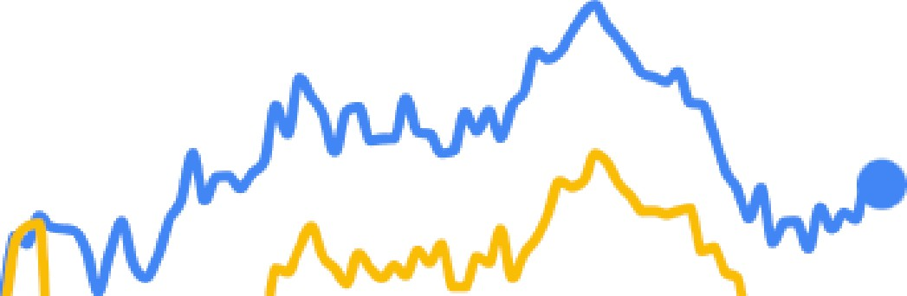
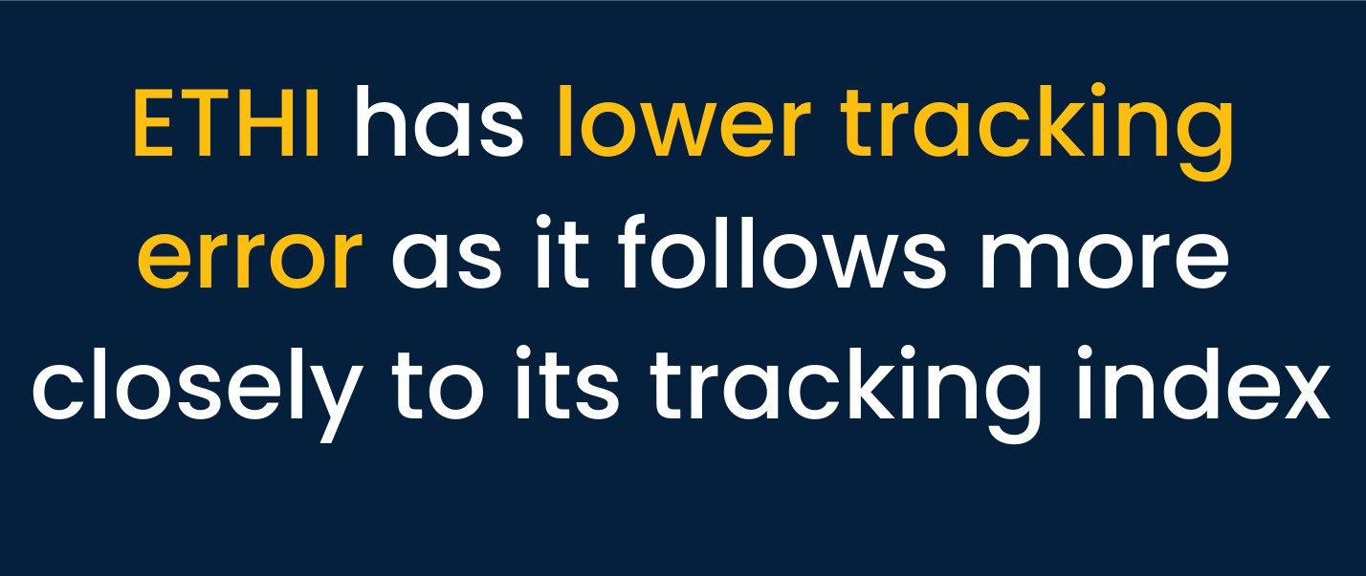

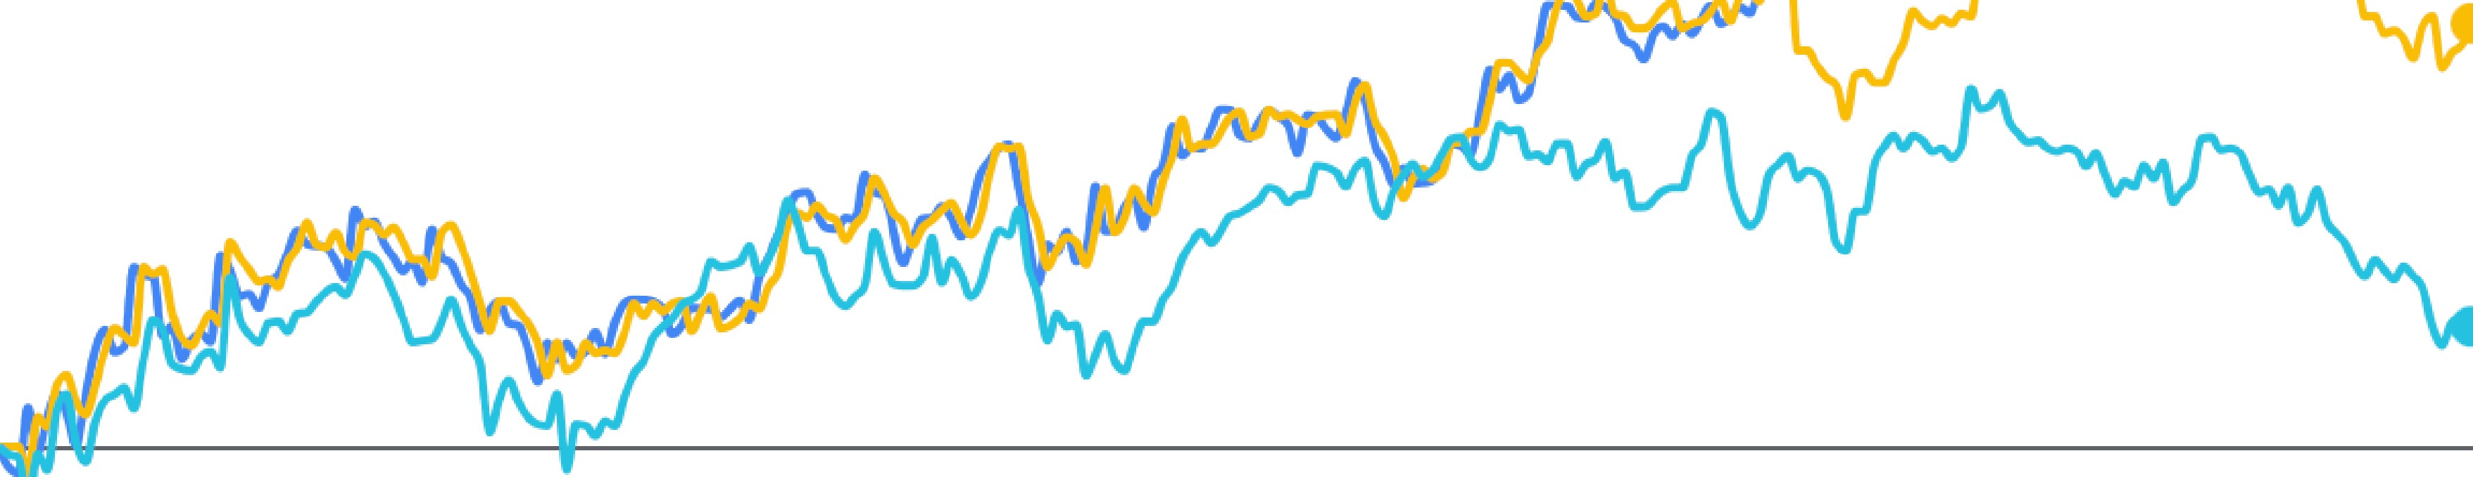

30%
25%
20%
15%
1 0%
5%
0%
—5°‹
i
Nov 2022
Jan 2023
Mar 2023
May 2023
Jul 2023
Sep 2023
The tracking error is a measure of how closely on ETF follows its benchmark or index.
• • • • • •
Trocking Index

Slide 14






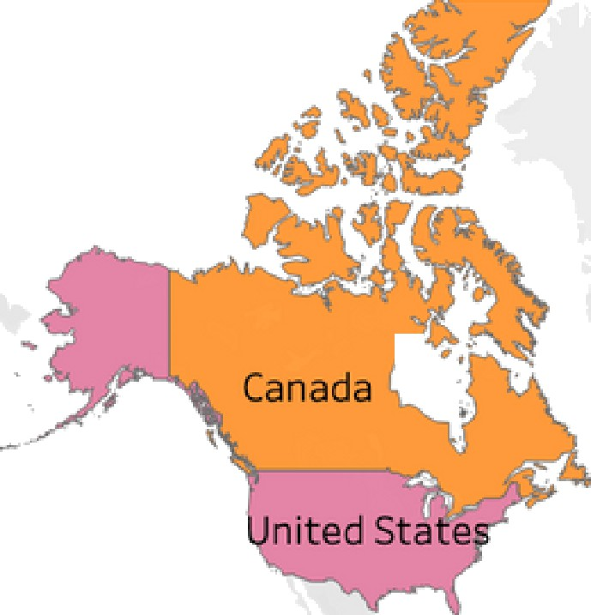



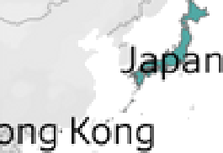

ick Look at the Past
Performance
Theme
Sustainable Leaders
ETF
ETHI FAIR
FUM($)
Top 10 Holdings
inicc Coprt I nc/Thc Toyota Motrr Co'p Adcbe nr
SaIe sly rr.e Inc
i\s a’\ I Vol Jirg N '
Sure c o p G c up Led
I ‹*.r›t ra LJrr›fJ[› Lt‹J
The Doshboord enobles user to See the post performonce of the selected ETFS storting 2017
zO22
202G
Transacted Volume
Ccchle z•° Ltd
Theme
FUM($)
Sustainable Leaders Australian Dividend Stocks Australian Top 200 Stocks Emerging Markets
Global 100 Stocks Healthcare Stocks SustainablR Leaders Tech Stocks
Z017 2JI8 2Cl9
Geographical Location
2CZ0
2021
20?2
2023
Sonic Hcaltncaro LU
Sector Allocation
Information Technology 32.40
Financials
22.50
Real Estate 19.50
Health Care 18.40
Financials 16.60
Needs
Health Care
15.60
Indust ria Is
11,60
Consumer Discretionary 14.10
Information
Te chn ola gy

Slide 15
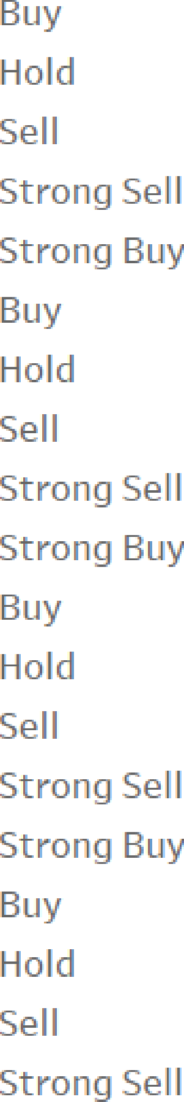






Market sentiment based on historic data
ASX .. •
VHY
Rating
Stroncg BUT
Aussie top 200 ond
Aussie Dividend both show o strong support towords buy side.
SYI
Anolysis suggest to buy IOZ and VHY
IOZ
0
50
100
160
zoo
3OO 3? 0
400
460
600
600
660
Rating Count
Your paragraph text

Slide 16







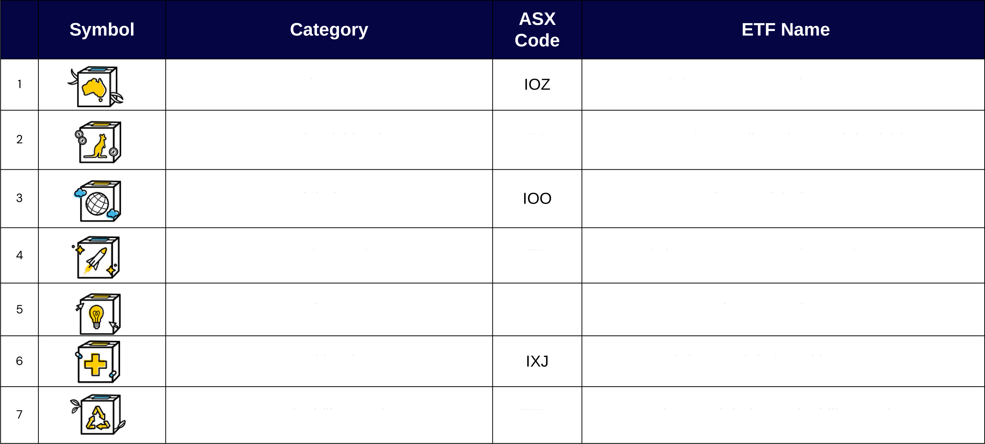
Aussie Top 200
ishares Core S&P/ASX 200 ETF
Aussie Dividends
VHY
Vanguard Australian Shares High Yield ETF
Global 100
IShares Global 100 ETF
Emerging Markets
IEM
ishares MSCI Emerging Markets ETF
Tech Savvy
ND@
BetaShares Nasdaq 100 ETF
Health Wise
ishares Global Healthcare ETF
Sustainability Leaders
ETHI
BetaShares Global Sustainability Leaders ETF

Slide 17
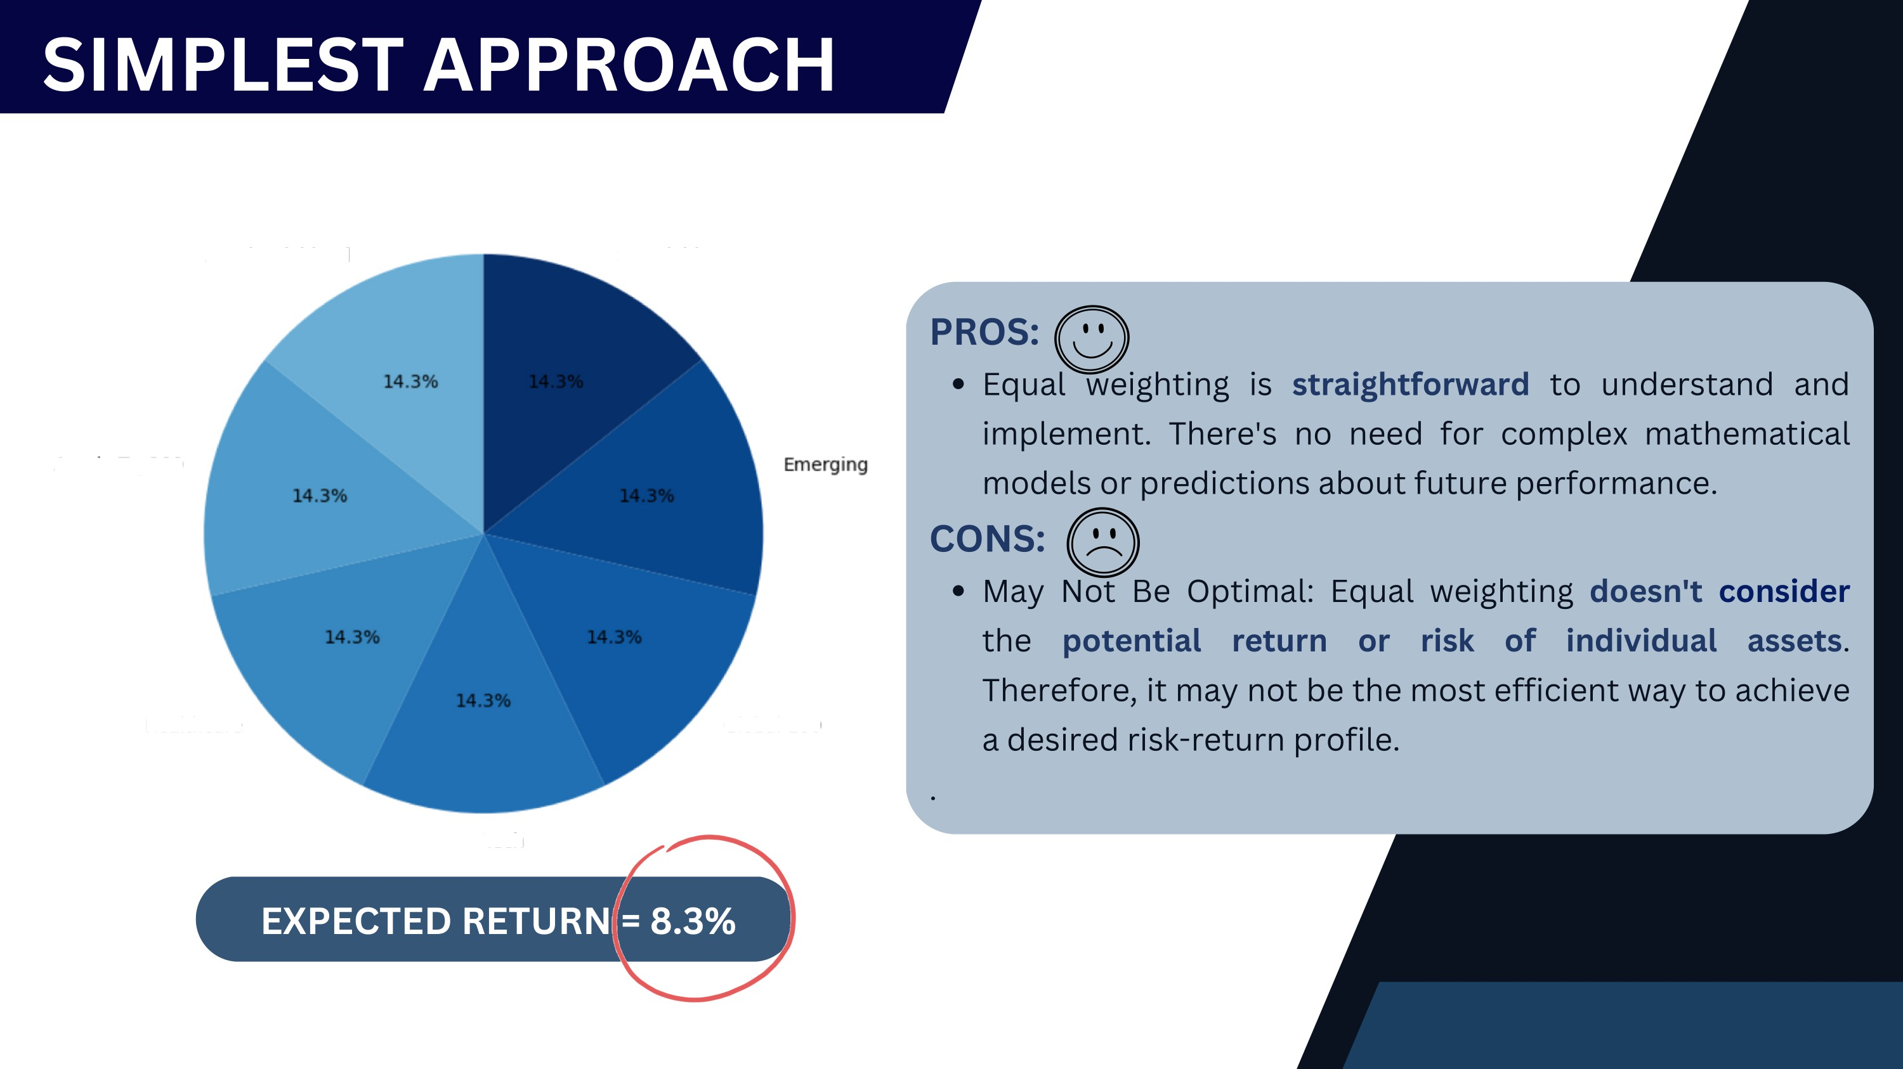

E/$UAL WEIGTHING
Aussie Dividend
Sustainble
Aussie Top3O0
Uealthcare
Global 100

Slide 18

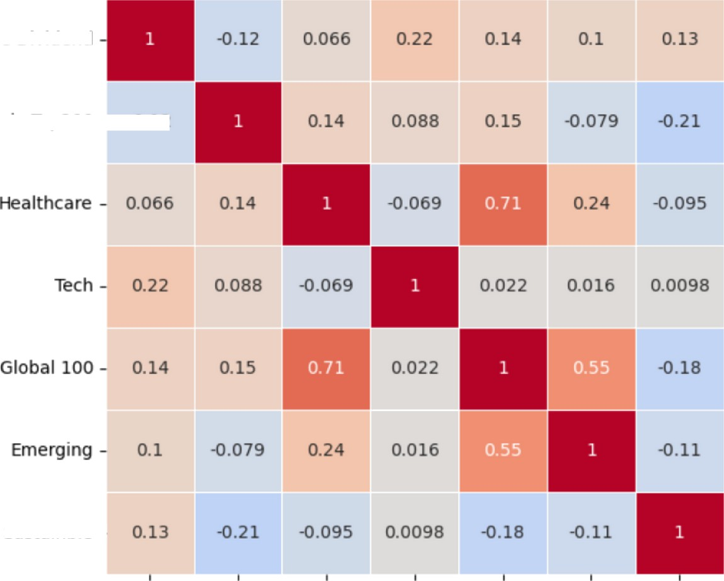
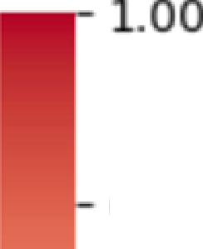

What is RSI?
Correlation Matrix based on RSI
Provides short-term buy and sell signals and is.
used to track the overbought and oversold levels of an asset
Correlatiomn atrix
Correlation tells us how different assets move in relation to each other
indicate correlation.
Red shades indicate positive correlation
Aussie Dividend
0.75
Aussie Top200 -
-0.12
- 0.25
-0.00
--0.25
- —0.50
--0.75
Lower Correlation IS preferred ËO achieve diversification. If ËWO ETFs are strongly positive correlated, we will not invest heavily i“n both as
their prices might drop at the same time.
Sustainble
--1.00
Aussie Dividend
Aussie Top2o
Healthcare›
Tech
Global 100
Emerging
Sustainble

Slide 19

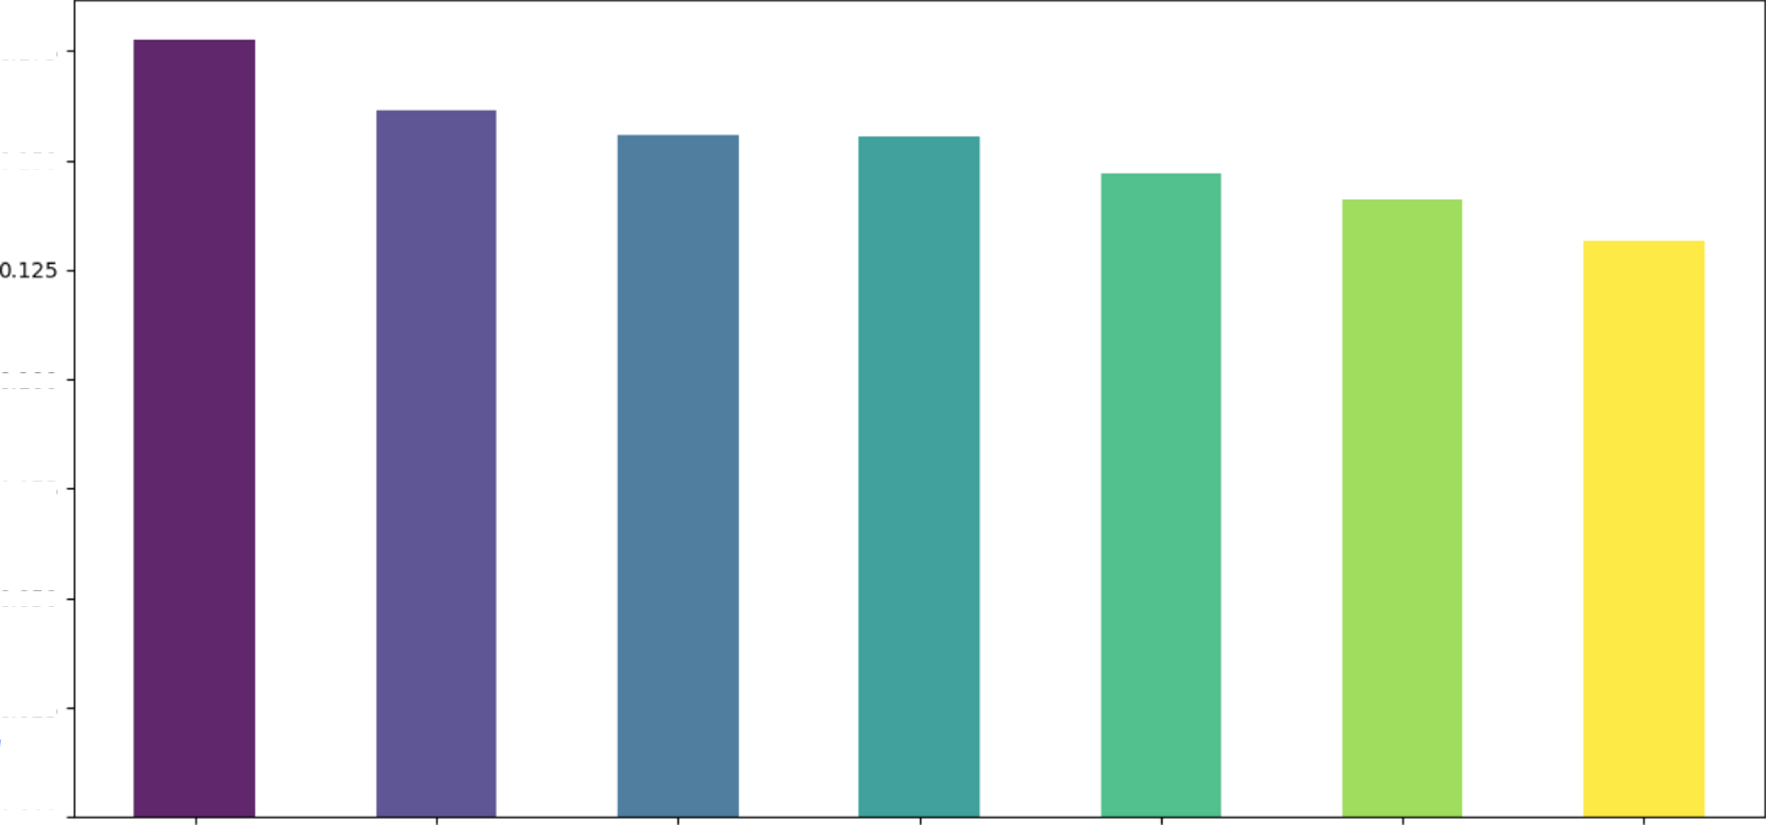

















The standard deviation of the returns (or price changes) are used
as a measure of risk or volatility.
A higher standard deviation indicates higher risk.
Risk (Standard Deviation of Returns) for Theme ETFs
o.175
Standard Deviation
0.100
0.075
0.050
0.025
0.000

Slide 20

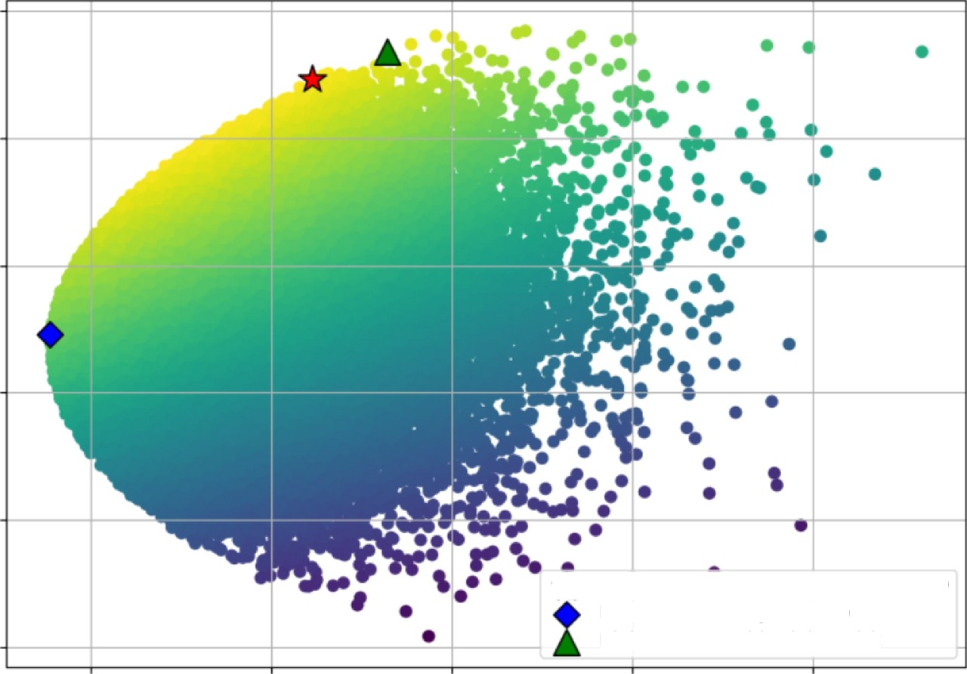
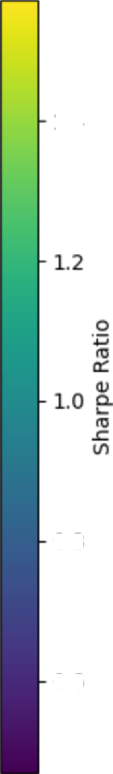
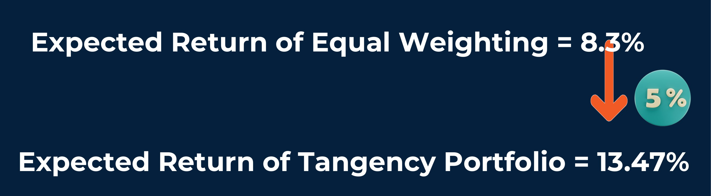

What is Efficient Frontier
Efficient Frontier
Represents a set of optimal portfolios that offer
the highest expected return for a given level of
O.14
risk .
1.4
0.12
Computed based on
expected
returns,
Portfolio Expected Annual Return
standard deviation, correlation and Sharpe
D.10
ratio. Random portfolio are generated using python to find the optimal portfolio to reach diversification.
0.08
0.8
0.06
Tangency Portfolio (Max Sharpe Ratio) Minimum Volatility Portfolio
Higher Return with Higher Risk
0.6
0.04
0.07
0.08
0.09 0.10
Portfolio Volatility \ Standard Deviation I
0.11

Slide 21

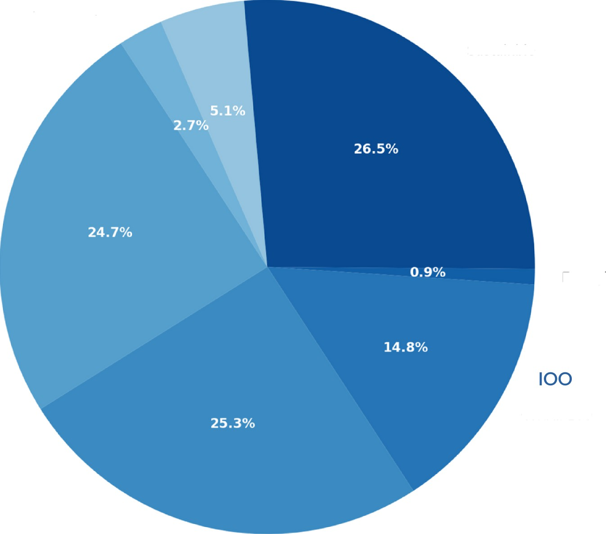


ASSET ALLOCATION
FOR TANGENCY
VHY
Aussie Dividend
PORTFOLIO
|{gy
Aussie Top200
ETHI
Sustainble
IXJ
Healthcare
IEM
Emerging
Global 1OO
Tech
NDQ

Slide 22
^{thr}....^{i}...^{v}....^{e}.... ^{ÇÛ},^{T•ț}

Slide 23


